Slide 1
Why Computational Text Analysis
Prof. Sebastián Vallejo Vera

Slide 2
In COMPUTATIONAL TEXT ANALYSIS there are two parts: the COMPUTATIONAL, and the TEXT ANALYSIS.
Scholars have been conducting TEXT ANALYSIS for some time now...

Slide 3
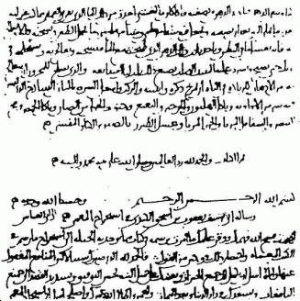
Al-Kindi (c. 9 AD) – On Deciphering Cryptographic Messages
Notes:
On Extracting Obscured Correspondence, more contemporarily: On Decrypting Encrypted Correspondence). In his treatise on cryptanalysis, he wrote:
One way to solve an encrypted message, if we know its language, is to find a different plaintext of the same language long enough to fill one sheet or so, and then we count the occurrences of each letter. We call the most frequently occurring letter the "first", the next most occurring letter the "second", the following most occurring letter the "third", and so on, until we account for all the different letters in the plaintext sample. Then we look at the cipher text we want to solve and we also classify its symbols. We find the most occurring symbol and change it to the form of the "first" letter of the plaintext sample, the next most common symbol is changed to the form of the "second" letter, and the following most common symbol is changed to the form of the "third" letter, and so on, until we account for all symbols of the cryptogram we want to solve.[

Slide 4
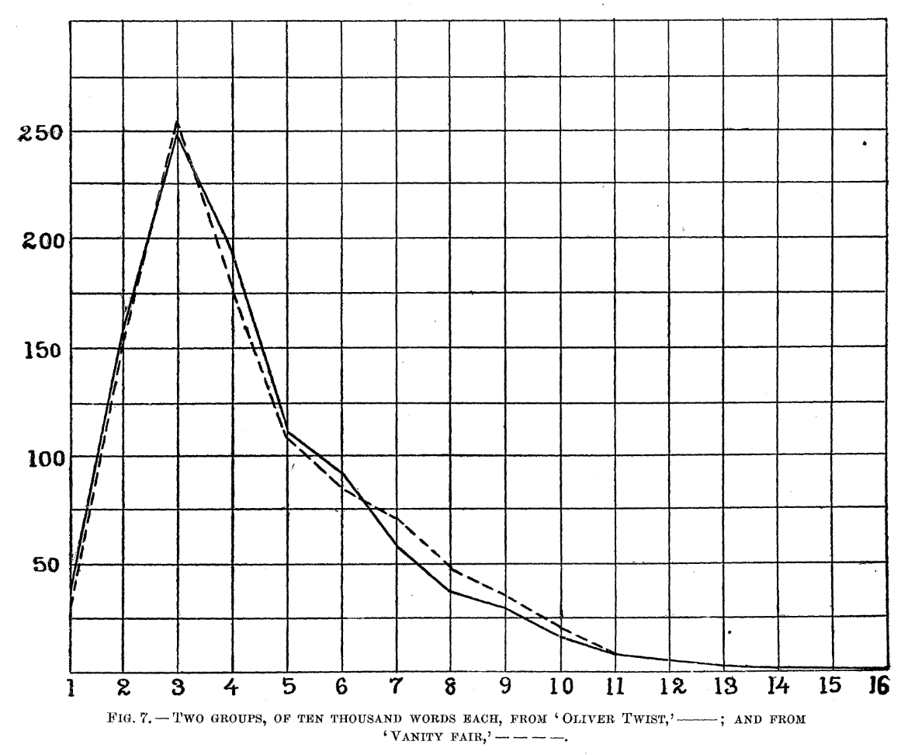
Mendenhall (1887) - The Characteristic Curves of Composition
Notes:
Mendenhall argues that if you take enough words from any given writer, you will eventually end up with the same distribution of word length (Poisson).

Slide 5
Holmes (1998) - The Evolution of Stylometry in Humanities Scholarship
“As the volume of available computer-readable literary texts continues to increase, we can expect expansion in the use of automated pattern recognition techniques, such as neural networks, to act as tools in the resolution of outstanding authorship disputes. Automated feature finders will be developed (see Forsyth and Holmes, 1996) to let the computer take over the task of finding the features that best discriminate between two candidate authors for a disputed text.”

Slide 6
In COMPUTATIONAL TEXT ANALYSIS there are two parts: the COMPUTATIONAL, and the TEXT ANALYSIS.
Scholars have been conducting TEXT ANALYSIS for some time now.
In recent years, the availability of machine-readable data and the development of more powerful tools have led to a greater focus on the COMPUTATIONAL part…

Slide 7
Why text?

Slide 8
Politicians love to speak.
Bureaucrats love to write.
People love to tweet.
There is text in every aspect of politics: debates on legislation, peace treaties, news reports, political manifestos, campaign speeches, social media, etc. Not only is text ubiquitous, but it is produced all the time (sometimes in real time).
And it can tell us a whole bunch of things…

Slide 9
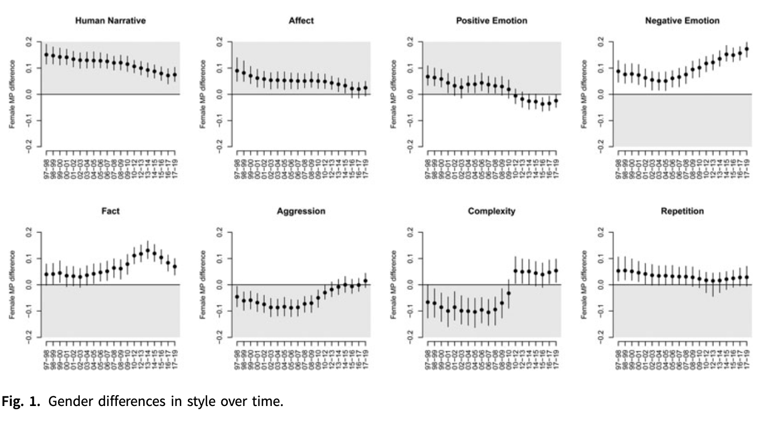
Track changing discourse across time…
Hargrave, L., & Blumenau, J. (2022). No longer conforming to stereotypes? Gender, political style and parliamentary debate in the UK. British Journal of Political Science, 52(4), 1584-1601.

Slide 10
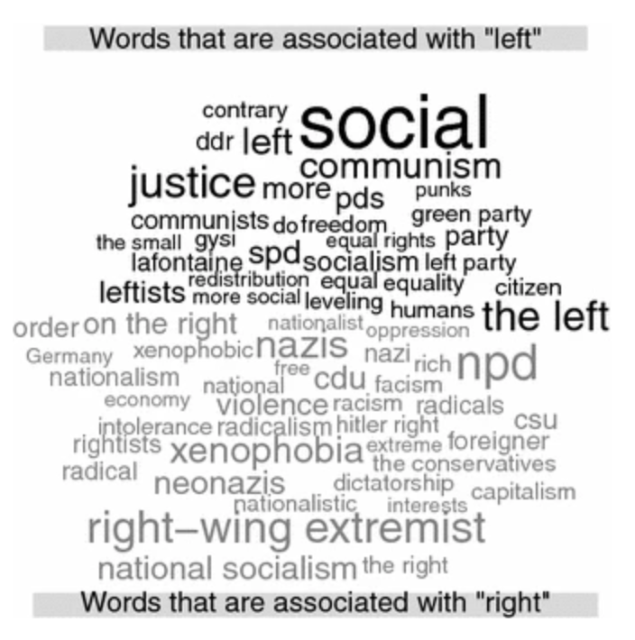
Provide context to concepts…
Bauer, P. C., Barberá, P., Ackermann, K., & Venetz, A. (2017). Is the left-right scale a valid measure of ideology? Individual-level variation in associations with “left” and “right” and left-right self-placement. Political Behavior, 39, 553-583.

Slide 11
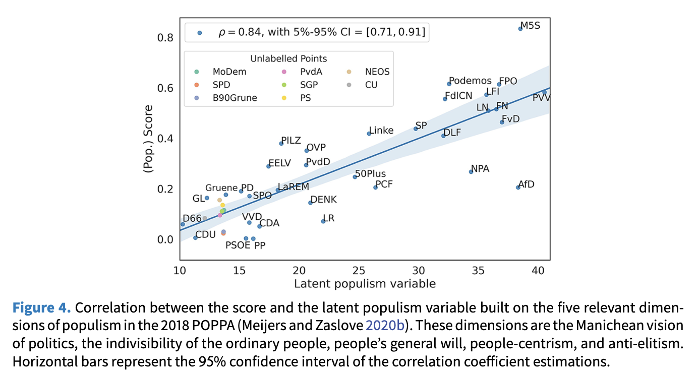
Find categories in text…
Di Cocco, J., & Monechi, B. (2022). How populist are parties? Measuring degrees of populism in party manifestos using supervised machine learning. Political Analysis, 30(3), 311-327.

Slide 12
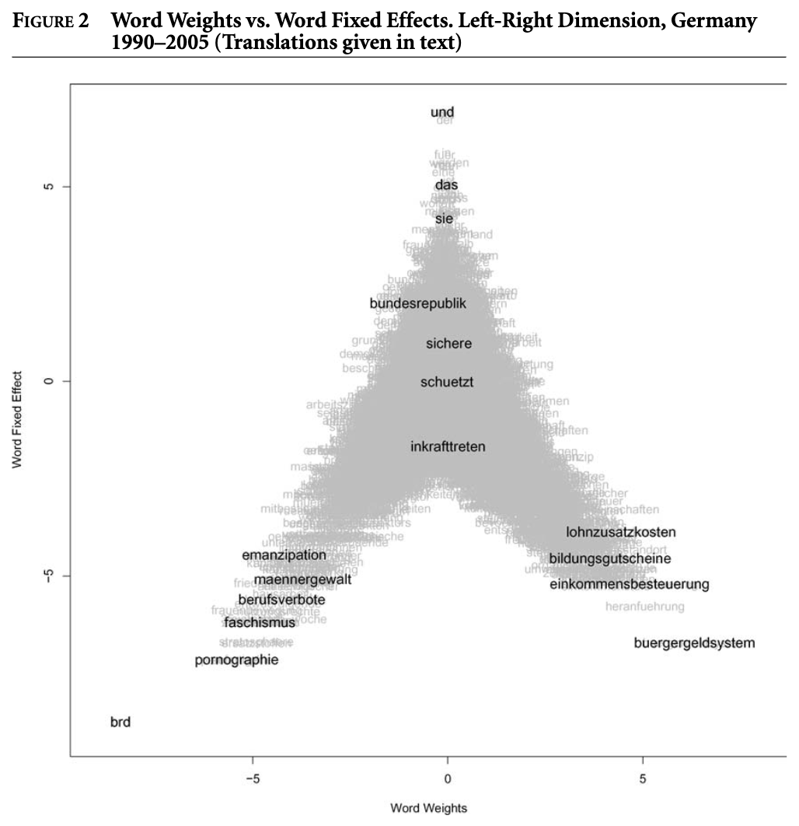
Make sense of vast number of documents…
Slapin, J. B., & Proksch, S. O. (2008). A scaling model for estimating time‐series party positions from texts. American Journal of Political Science, 52(3), 705-722.

Slide 13
Where do we find all this text?

Slide 14
Short answer:
The internet.

Slide 15
Long answer:
Large-scale digitalization of records and the increasing amount of public data online make the internet a great source.
There are corpora from Parliamentary speeches readily available for many countries. For example:
  UK: https://cran.r-project.org/web/packages/hansard/index.html
  Canada: https://www.lipad.ca/
For other countries, there are probably corpora that are one friendly email away:
  The Politics of Legislative Debates: https://global.oup.com/academic/product/the-politics-of-legislative-debates-9780198849063?cc=ca&lang=en&

Slide 16
With the proper web-scrapping tools (Week #7), or looking in the right places, most repositories in the web can be used as corpora:
  Wikipedia: https://en.wikipedia.org/wiki/Wikipedia:Database_download
  Project Gutenberg: https://cran.r-project.org/web/packages/gutenbergr/vignettes/intro.html
  Internet Archive: https://archive.org/details/datasets
  Google Books: http://storage.googleapis.com/books/ngrams/books/datasetsv2.html
Twitter was ripe with text data readily available for researchers before Musk, but now that well has dried out. However, there are some people who keep data downloaded from Twitter stored in big computers 🫡.

Slide 17
Another great source are the open-answered questions from surveys or transcripts from interviews.
You can even use transcripts from YouTube videos.
You can also get diligent. I obtained all the legislative speeches from the Ecuadorian Congress from 1979 to 2023, asking the Ecuadorian Congress Library to share them with me.
In general, a bit of creative thinking goes a long way… Any other ideas in the room?

Slide 18
Legal issues
(“…but the will of your class made into a law for all, a will whose essential character and direction are determined by the economical conditions of existence of your class.”)

Slide 19
Be wary of legal issues…
Is content copyrighted? Does scraping infringe IP rights?
Are there “terms of use” or “terms of services”?
Remember that, most importantly, legal DOES NOT MEAN ethical. (In my book, ethical >> legal).
But you still be careful.

Slide 20
Why use a computer?

Slide 21
Humans are great at understanding and analyzing the content of texts. Computers are not.
Humans are also great at not being able to read thousands of documents in minutes, organize that text, classify that text, scale that text, and then produce pretty graphics from that text. Computers are not not that. (I stand by the double negative)
We will be learning about the latter.

Slide 22



See Week #9
Humans are great at understanding and analyzing the content of texts. Computers are not.
Humans are also great at not being able to read thousands of documents in minutes, organize that text, classify that text, scale that text, and then produce pretty graphics from that text. Computers are not not that. (I stand by the double negative)
We will be learning about the latter.

Slide 23
Note: Text analysis is not a field, it is a tool. Think about it as a regression where the data are words instead of numbers. Thus, the fanciest of text analysis techniques is no good without a well thought out, substantive, theoretically motivated question.

Slide 24
Basic assumptions
(We will return to these)

Slide 25
When doing quantitative text analysis, we assume:
  That texts represent an observable implication of some underlying characteristic of interest (an attribute of the author, the subject, ...)
  That texts can be represented through extracting their features--e.g., words--, or evaluating how these features interact in context—e.g., convolutional neural networks.
  That we can analyze the frequency of features (as a document-feature matrix) with quantitative methods to measure these underlying characteristics, or we can analyze the interaction of these features to predict characteristics of the text.

Slide 26
There are two big approaches to computational text analysis:
  Bag-of-words
  Word embeddings

Slide 27
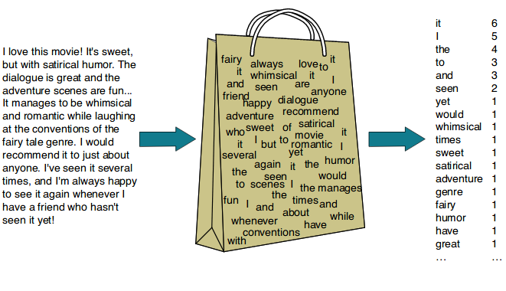
Bag-of-Words

Slide 28
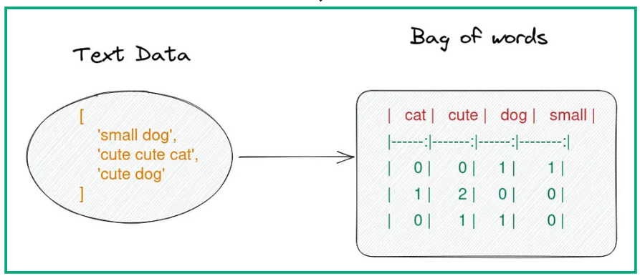
Bag-of-Words

Slide 29
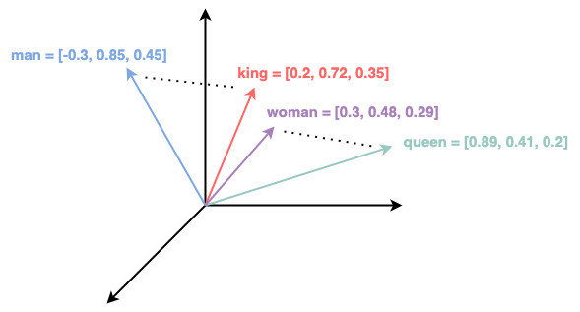
Word Embeddings

Slide 30
In this class we will study both approaches and, most importantly, how and when we can apply them in our research.
Much like Marx, who began his multi-volume analysis of capitalism by studying the basic unit, the commodity, we will begin by studying “the word” or “the token”.
Before we leave, think about the following:

Slide 31
Four principles of automated text analysis
Grimmer and Stewart (2013)

Slide 32
All Quantitative Models of Language Are Wrong—But Some Are Useful
Data generation process for text is unknown.
Language it too complex for computers to correctly decipher (e.g. “Time flies like an arrow. Fruit flies like a banana.”).
Since language is so context-specific, more complex models are rarely more useful for the analysis of texts.

Slide 33
Quantitative Methods Augment Humans, Not Replace Them
You need to read the text, know the text, be the text.
Computers organize, direct, and suggest.
Humans read and interpret.

Slide 34
There Is No Globally Best Method for Automated Text Analysis
Different needs require different methods.
Even when you have the same needs, the same model might not fit the data.

Slide 35
Validate, Validate, Validate
Outputs can be misleading (or simply wrong).
It is incumbent upon you, the researcher, to validate the use of automated text analyses.

